Slide 1
Analytics for a Better World Recitation 7

Slide 2
Schedule
Homework
Projects
Topic Review
Logistic Regression and Binary Classifiers

Slide 3
Homework
Homework 2 feedback is out
Homework 3 is due tonight
Homework 4 was released Wednesday and is due Monday April 4th.
The topics are logistic and linear regression

Slide 4
Projects
Project guidelines are posted on canvas.
Your project proposals are due 2 weeks from today.

Slide 5
Topic Review
Past Week:
Lecture 14 Covid Analytics Part 2
Lecture 13 Framingham Part 2, Covid Analytics Part 1
Earlier:
Lecture 12 Predicting Healthcare Quality, Framingham Part 1
Lecture 11 Optimization with Constraint Learning
Lecture 10 Healthcare Accessibility via Road Network Improvement
Lecture 9 Hospital Location Optimization in Timor-Leste
Lecture 8 Dike Height Optimization
Lecture 7 Locations of UN Humanitarian Response Depots
Lecture 6 HDR Brachytherapy Treatment
Lecture 5 Cattle Feed for Small Farmers
Lecture 4 Integer Optimization
Lecture 3 World Food Program
Lecture 2 Linear Optimization
Lecture 1 Introduction

Slide 6
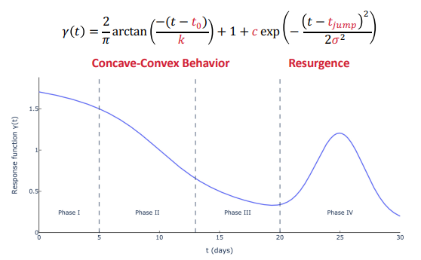
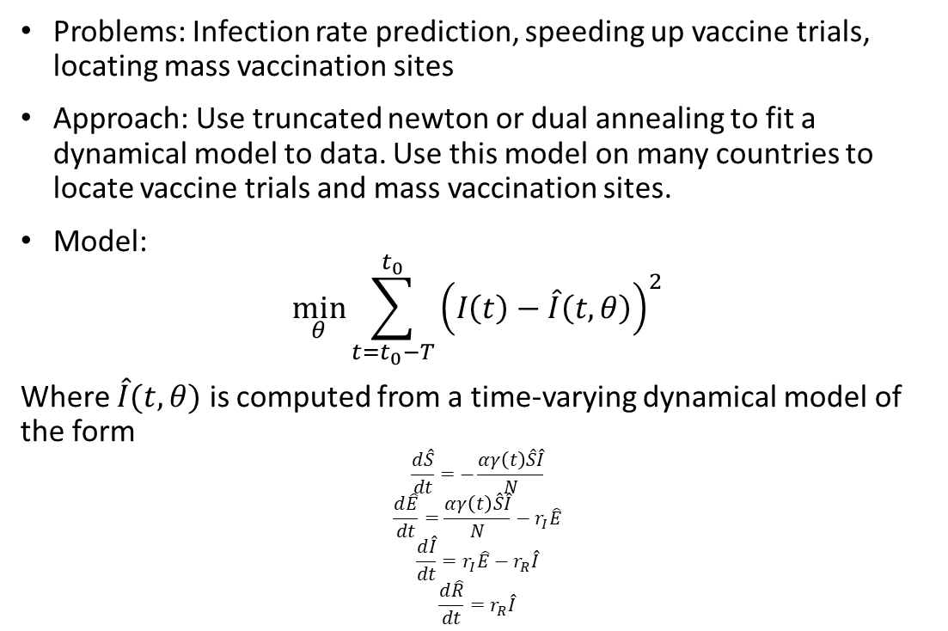
COVID-19 Analytics
Problems: Infection rate prediction, speeding up vaccine trials, locating mass vaccination sites
Approach: Use truncated newton or dual annealing to fit a dynamical model to data. Use this model on many countries to locate vaccine trials and mass vaccination sites.
Model:
$$\min_{θ}{\sum_{t=t_{0}−T}^{t_{0}}{{\left(I\left(t\right)−\hat{I}\left(t,θ\right)\right)}^{2}}}$$
Where $\hat{I}(t,θ)$ is computed from a time-varying dynamical model of the form
$$\frac{d\hat{S}}{dt}=−\frac{αγ\left(t\right)\hat{S}\hat{I}}{N}$$
$$\frac{d\hat{E}}{dt}=\frac{αγ\left(t\right)\hat{S}\hat{I}}{N}−r_{I}\hat{E}$$
$$\frac{d\hat{I}}{dt}=r_{I}\hat{E}−r_{R}\hat{I}$$
$$\frac{d\hat{R}}{dt}=r_{R}\hat{I}$$

Slide 7
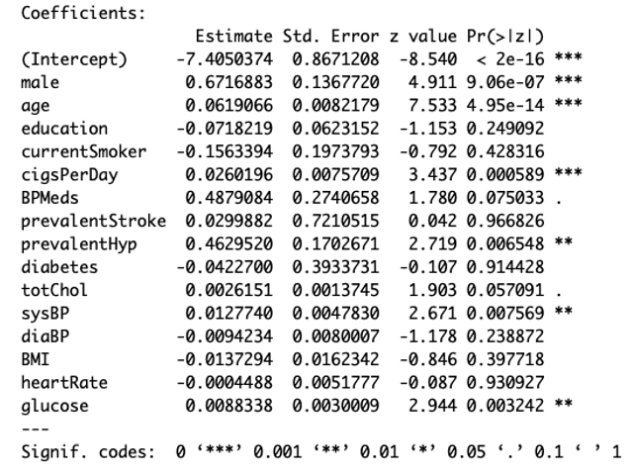
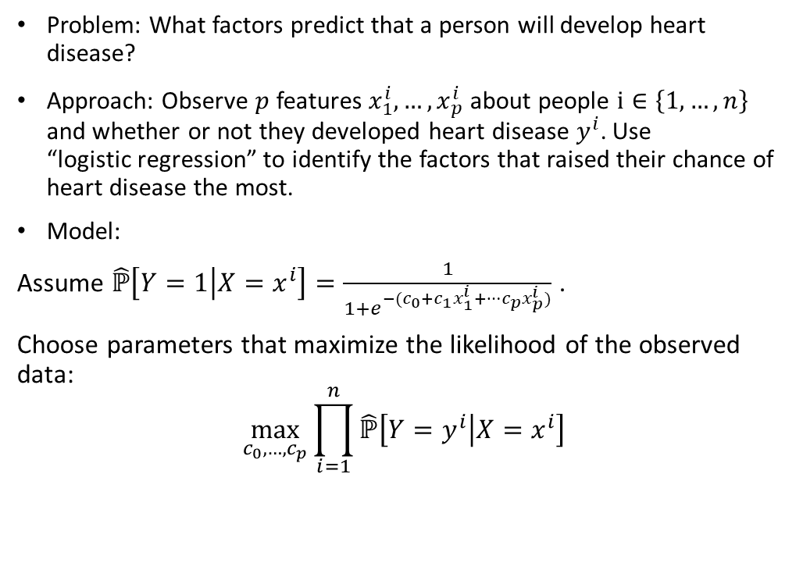
Framingham Heart Study
Problem: What factors predict that a person will develop heart disease?
Approach: Observe $p$ features $x_{1}^{i},…,x_{p}^{i}$ about people $i∈\left\{1,…,n\right\}$ and whether or not they developed heart disease $y^{i}$. Use “logistic regression” to identify the factors that raised their chance of heart disease the most.
Model:
Assume $\hat{ℙ}\left[Y=1 | X=x^{i}\right]=\frac{1}{1+e^{−(c_{0}+c_{1}x_{1}^{i}+…c_{p}x_{p}^{i})}}$ .
Choose parameters that maximize the likelihood of the observed data:
$$\max_{c_{0},…,c_{p}}{\prod_{i=1}^{n}{\hat{ℙ}\left[Y=y^{i} | X=x^{i}\right]}}$$

Slide 8
Logistic Regression and Binary Classifiers
Probability, Odds, Logit – 3 Measures of Uncertainty
Logistic Regression
Fitting a Logistic Regression Model
Evaluating a Logistic Regression Model
Creating a Binary Classifier from a Logistic Regression Model
Carrying out Logistic Regression in Practice
Handwritten notes and Jupyter notebook attached
Desmos plot at https://www.desmos.com/calculator/qwcvutcjfr

